Slide 1
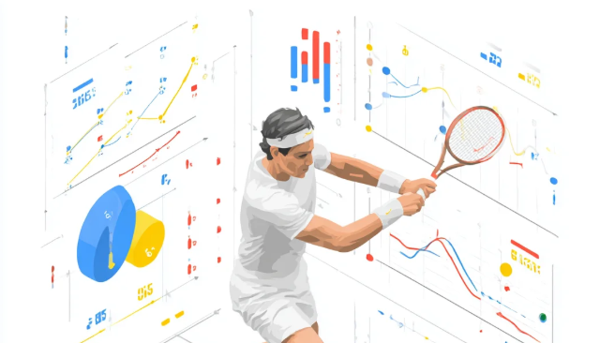
DS 207 Final Project

Slide 2
Predicting ATP Tennis Match Outcomes with Machine Learning
Georgios Friligkos

Slide 3

Motivation
Sports analytics and tennis performance modelling
Rich dataset with ranking and serve-related statistics
Previous work used Logistic Regression (Friligkos, 2023)
Hypothesis: nonlinear models improve prediction accuracy

Slide 4
Dataset
Source: Jeff Sackmann ATP dataset (50+ years)
70k+ matches → 65k after cleaning
Features: rankings, ages, serve stats, surface, tournament level
Target variable: match winner (1/0)

Slide 5
Preprocessing AND FEATURE ENGINEERING
Difference features (rank_diff, ace_diff, df_diff, bp_saved_diff)
One-hot encoding for categorical variables
Removed missing rows
Time-based split: Train ≤2015, Val 2016–17, Test ≥2018

Slide 6
Exploratory Data Analysis(EDA)
Rank difference strongly correlated with outcomes
Serve performance metrics are predictive
Surface effects observed (clay vs hard)
Motivates nonlinear modelling

Slide 7
Models Implemented
Baseline: Logistic Regression
Ensemble models: Random Forest, XGBoost
Neural Network (MLP)
Same dataset & split across all models

Slide 8
Evaluation Metrics
Accuracy
F1-score
ROC-AUC
Consistent evaluation with test split

Slide 9
Results Summary
XGBoost achieved highest ROC-AUC (0.795)
Random Forest also strong performer
Neural network similar to logistic regression (tabular data)
 | Model | Accuracy | F1 | ROC-AUC
1 | Logistic Regression | 0.717000 | 0.715000 | 0.780000
2 | Random Forest | 0.724367 | 0.723982 | 0.793062
3 | XGBoost | 0.724434 | 0.723846 | 0.795331
4 | Neural Network | 0.710147 | 0.710012 | 0.776142

Slide 10
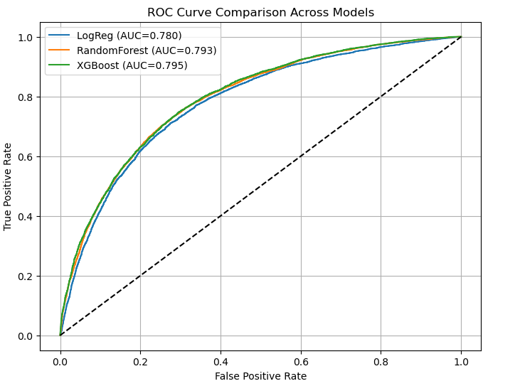
ROC Curve Comparison
Ensemble models outperform logistic regression
XGBoost provides best discrimination across thresholds

Slide 11
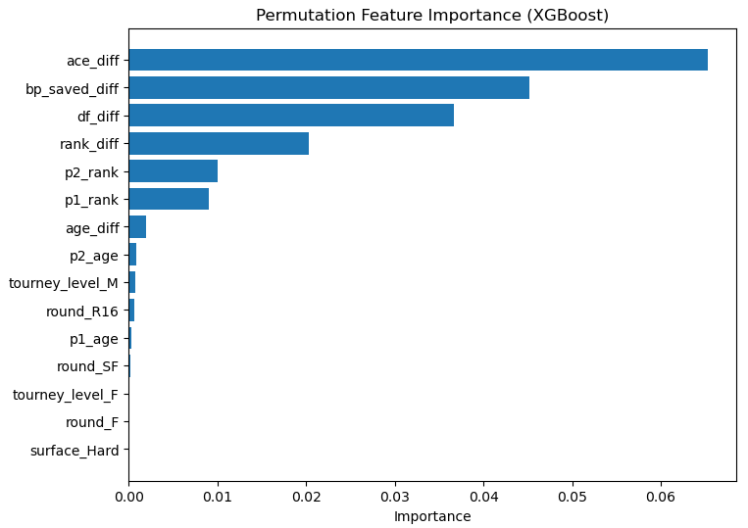
Feature Importance
Top predictors: rank_diff, ace_diff, bp_saved_diff, df_diff
Serve performance is crucial for match outcomes
Aligned with tennis intuition

Slide 12
Conclusions
Nonlinear models outperform linear baseline
XGBoost provides best performance
Serve metrics + ranking differences are key drivers

Slide 13
Future Work
Include player recent form (rolling averages)
Head-to-head history
Surface-specific strengths
Point-by-point statistics
Incorporation of NLP-based features

Slide 14

Thank you

